Slide 1


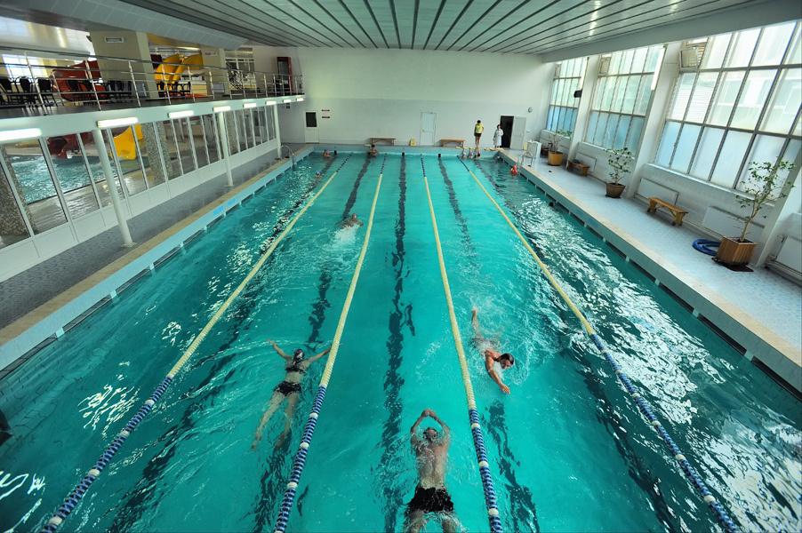
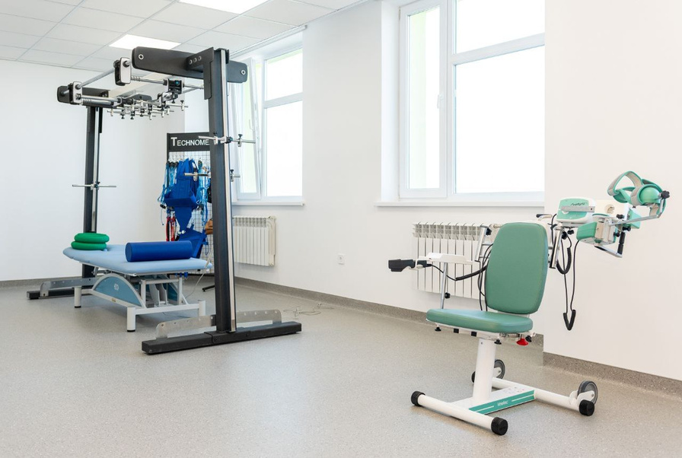
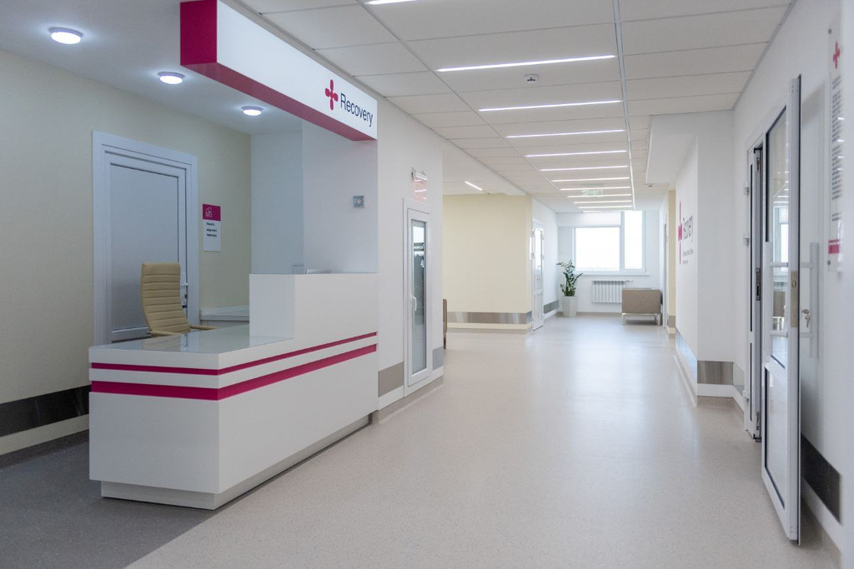

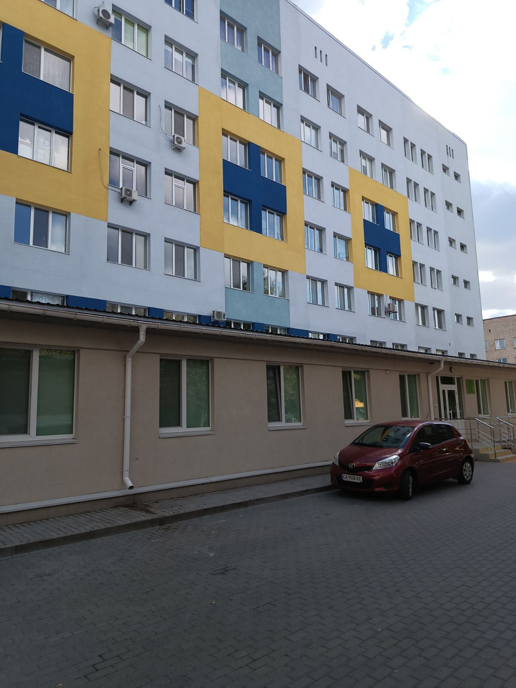


Overhaul of Municipal non-profit enterprise «Third Cherkasy City Emergency Hospital"
(rehabilitation department)

Slide 2

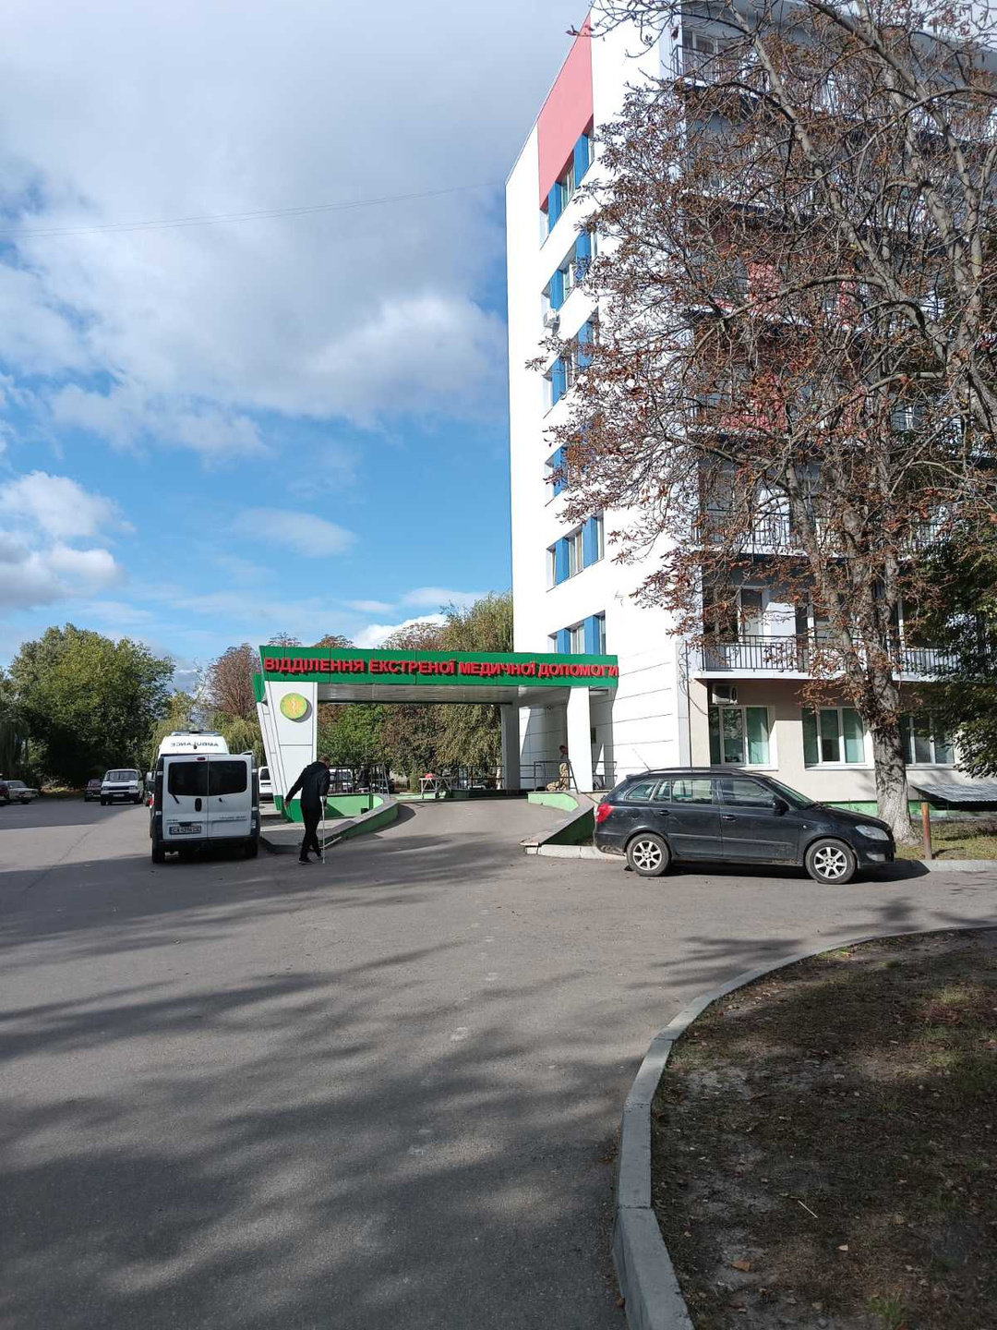

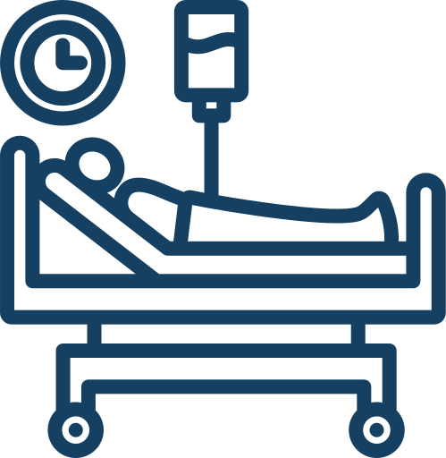
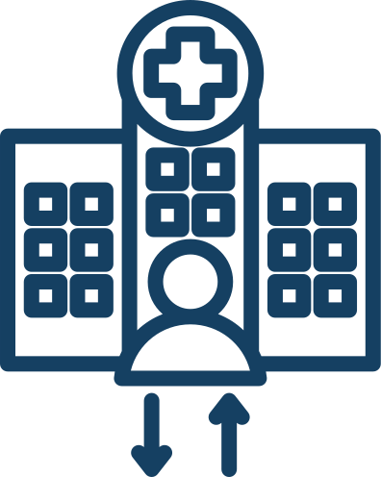

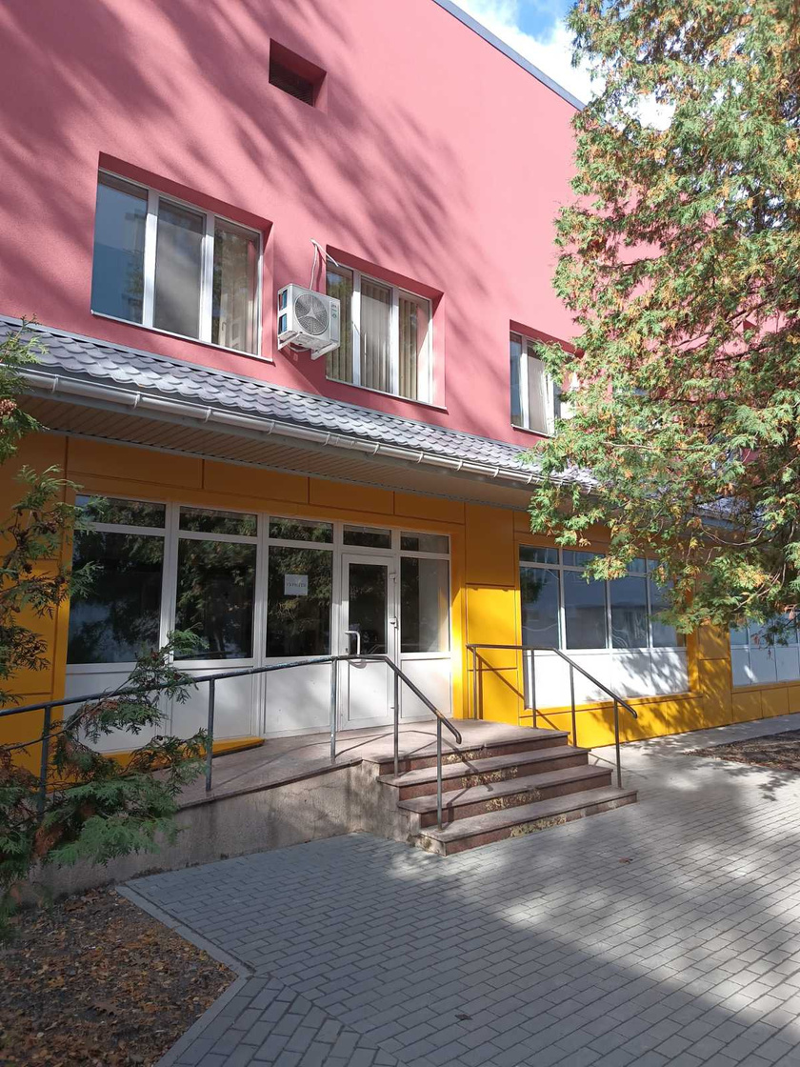





Overhaul of Municipal non-profit enterprise «Third Cherkasy City Emergency Hospital"
(rehabilitation department)
The number of people who received service in the department:
inpatient rehabilitation – 1 421 people
outpatient rehabilitation – 2 235 people
Specialized assistance is available 24/7
The total cost of the project is
≈ 1 304 500 EUR

Slide 3

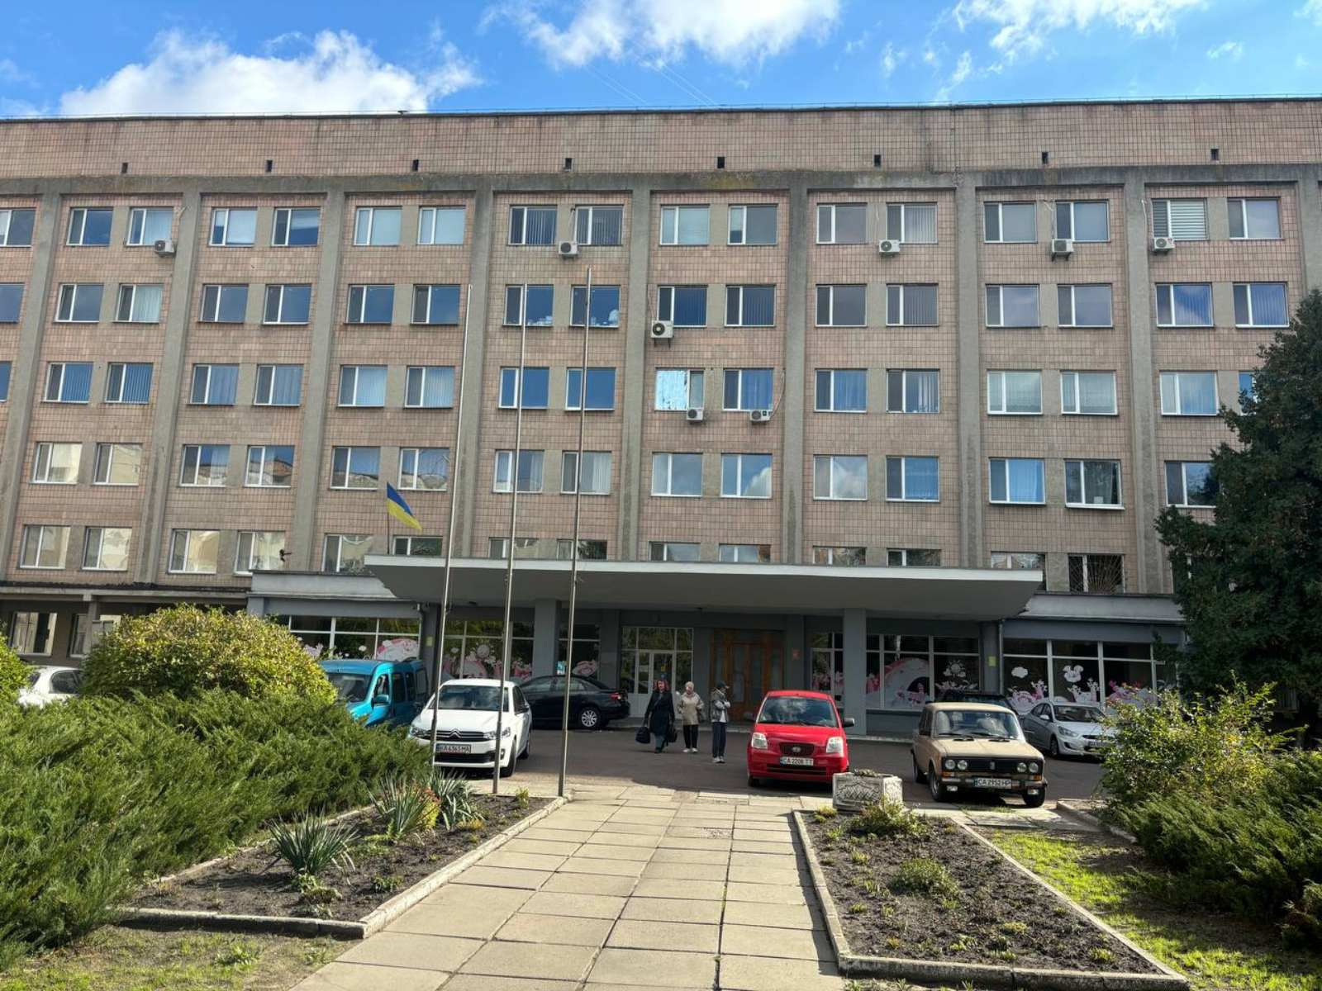

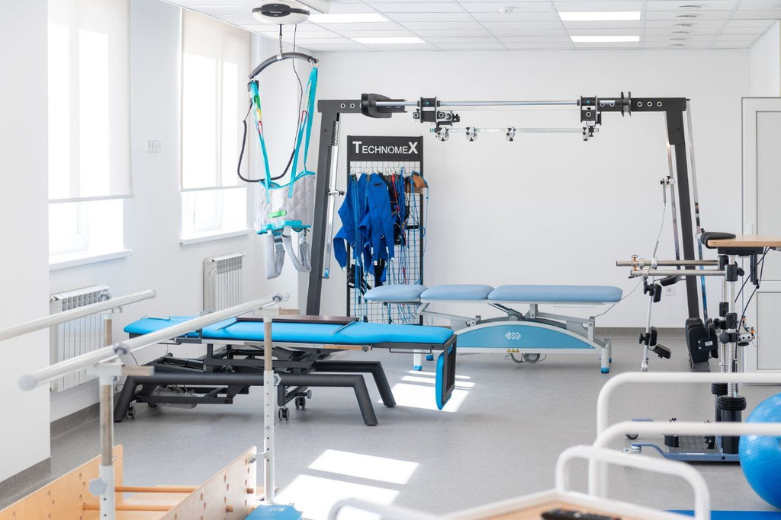


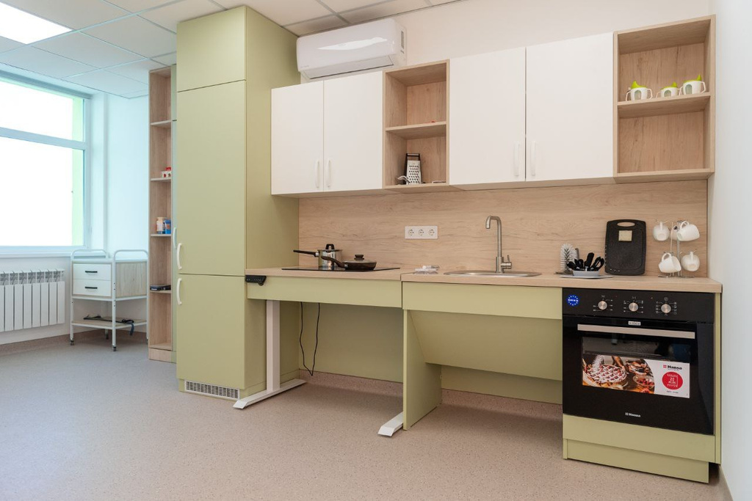


The project includes the following works:
reconstruction of wards and halls for rehabilitation
replacement of external windows and doors
replacement of internal water supply and drainage networks
replacement of floor coverings
replacement of electrical networks and equipment
internal construction and installation works

Slide 4
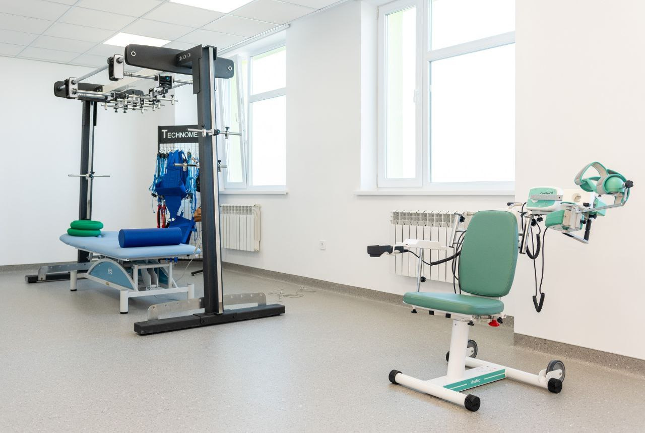
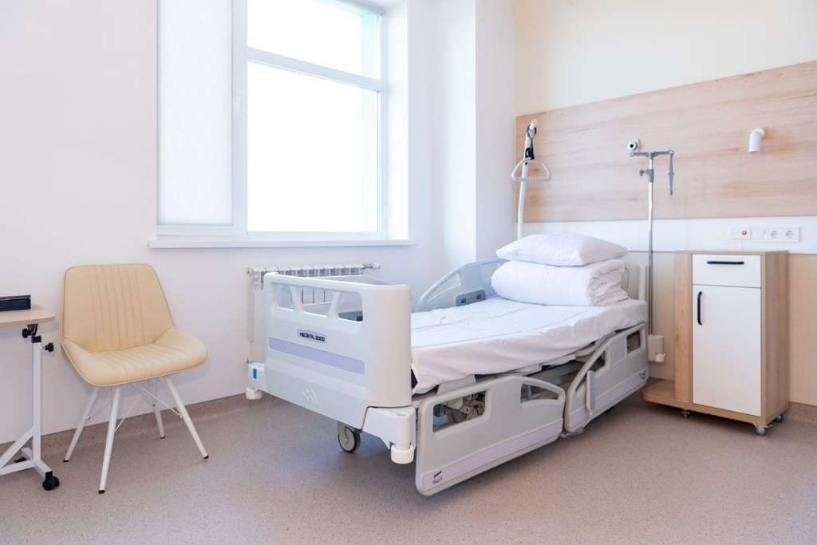

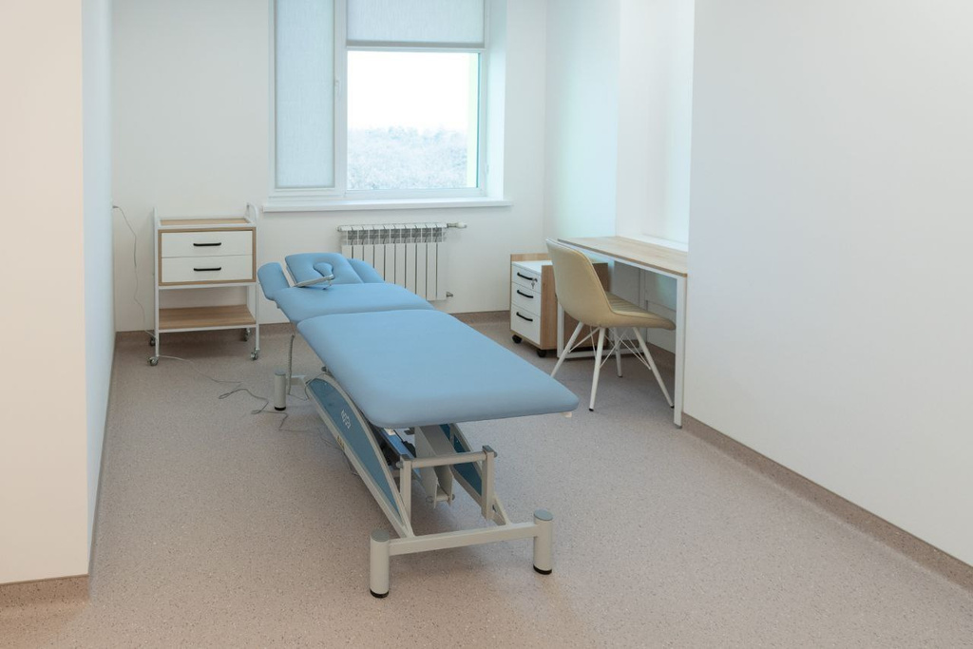

Carrying out repair work will ensure:
creation of the largest rehabilitation department in Cherkasy with an area of ​​2200 sq.m.
arrangement of wards for 60 beds with the stay of 2 people in a ward and a sanitary room
will provide the possibility of carrying out individual rehabilitation procedures

